Slide 1
Overview of LMS Software Engineering CSE435 Michigan State University Fall 2022
Team members:
Project Manager: Ben Gibbons
Facilitator: Tyson Lance
Security Manager: Zack Joyce
Customer Liaison: Michael Monticciolo
Artifacts Manager: Ian Berriel
Customer: Ayush Agrawal
Instructor: Dr. Betty H.C. Cheng*
*Please direct all inquiries to the instructor.
Notes:
‹#›

Slide 2
Project Overview
System provides functionality for lane keeping on a vehicle.
The motivation for this project was to create a safer and easier driving experience.
Notes:
‹#›

Slide 3
Project Overview
The LMS project helps to address the human element of driving.
It facilitates more predictable, safer movements by vehicles on the road by keeping drivers centered in their lanes.

Slide 4
Overview of Features
Software
Hardware
Notes:
‹#›

Slide 5
Overview of Features
Lane Keeping System
Lane Departure Warning System
Lane Centering System
User Interface
Camera Sensing Subsystem

Slide 6
Overview of Features
Functionality Toggle Button
Activation Indicator
Operator Override
Turn Signal Override

Slide 7
Domain Research
The background research consisted of learning about how modern vehicles are controlled via their ECU (the car’s computer).
Needed to apply domain knowledge on what subsystems within a vehicle are managed by the ECU and the functionality they offer.
Project Constraints
LMS will only take action in situations where it believes it is 100% sure of the situation
LMS will have internal system checks to guarantee that the system is operating correctly
Alerts will not irritate the vehicle operator, but still be enough to inform them
Notes:
‹#›

Slide 8
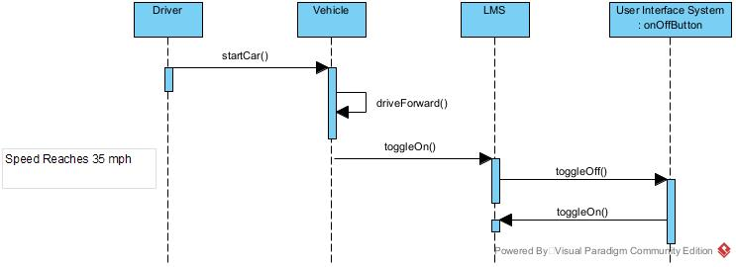
Part II: Model-based View of System
Turning on the System
This figure shows turning on the system
It demonstrates two different ways to turn on the system
Notes:
‹#›

Slide 9
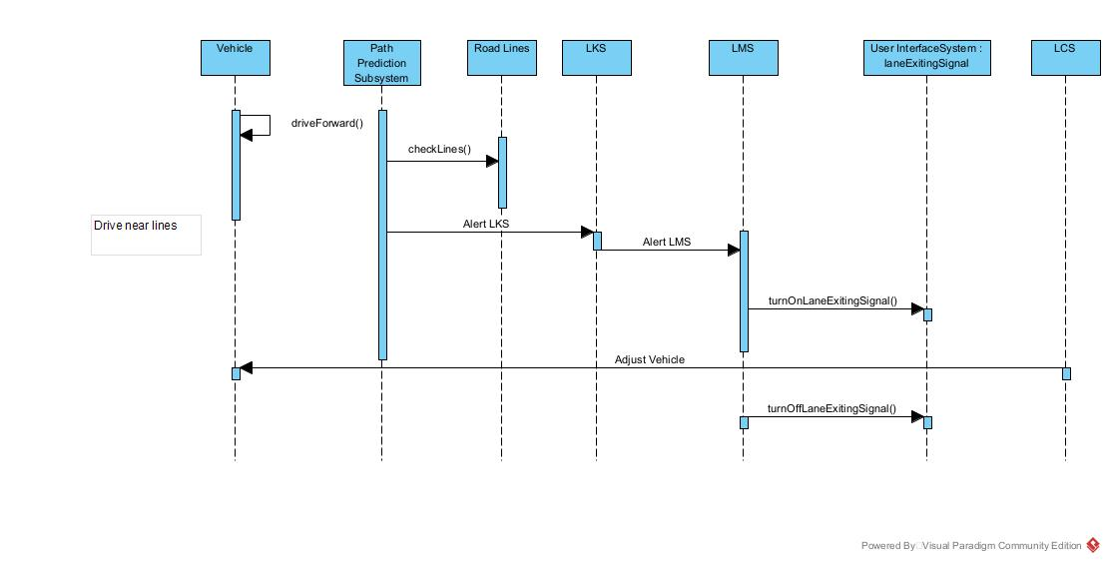
Part II: Model-based View of System
LKS Taking Over Control
This figure shows the LMS when the vehicle is leaving the lane
Notes:
‹#›

Slide 10
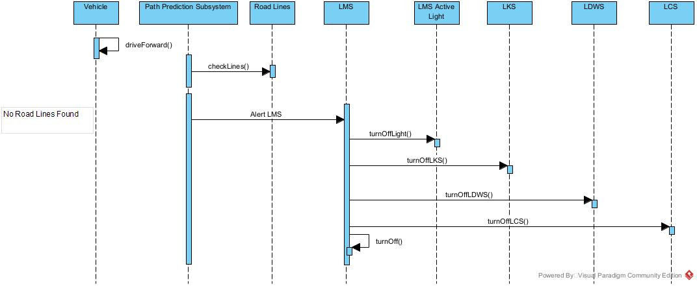
Part II: Model-based View of System
No Visible Road Lines
This figure shows the LMS turning off when there are no visible road lines
Notes:
‹#›

Slide 11
Part III: Demonstration
-Our prototype was creating using Unity 3D, along with 2 free assets from Unity’s Asset Store for the car model and highway texture used.
-The prototype demonstrates the functionality of the LMS system on a curved highway through multiple scenarios
Notes:
‹#›

Slide 12
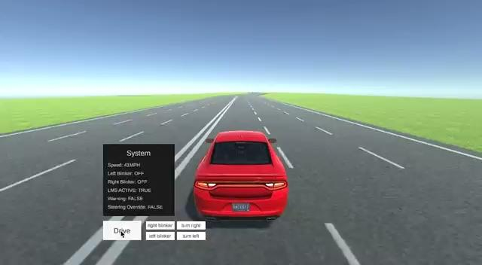
Scenario 1:
Car accelerates past 35 MPH, LMS system is activated. LDWS and LCS are inactive.

Slide 13
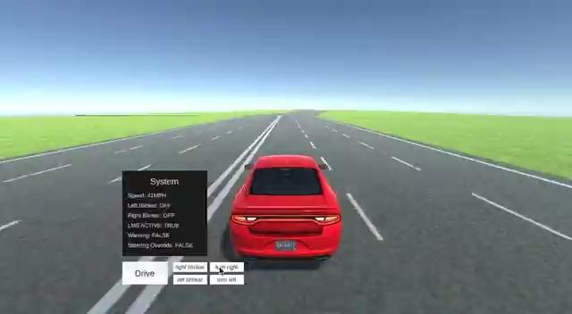
Scenario 2:
Car begins exiting lane to the right without blinker, LDWS activates then LCS recenters the vehicle.

Slide 14
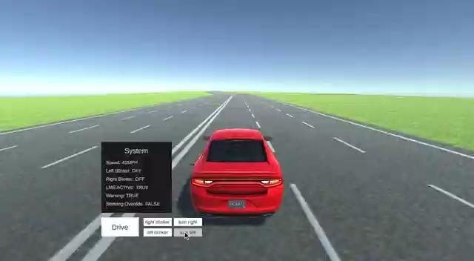
Scenario 3:
Car begins exiting lane to the left without blinker, LDWS activates then LCS recenters the vehicle.

Slide 15
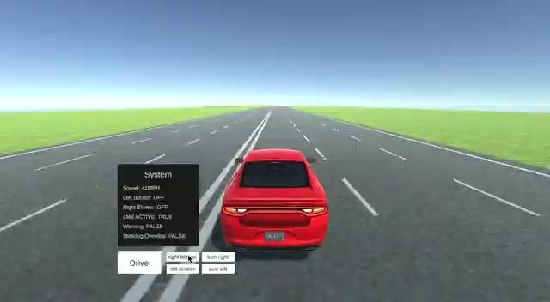
Scenario 4:
Car begins exiting lane to the right with right blinker on, LMS still active but no other systems turn on, car successfully changes lanes.

Slide 16
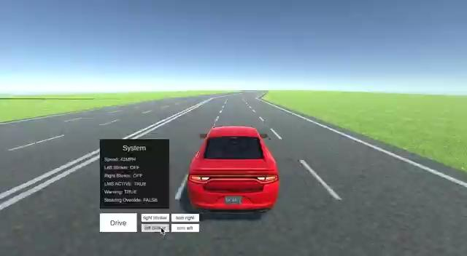
Scenario 5:
Car begins exiting lane to the left with left blinker on, LMS still active but no other systems turn on, car successfully changes lanes.

Slide 17
Acknowledgements
We gratefully acknowledge and appreciate the participation of our customer, Ayush Agrawal from Amazon

